Slide 1
PREDICTING McDONALDs “RUDE” REVIEWS
VIA SENTIMENT ANALYSIS
PRAVEEN SEQUEIRA DATA SCIENTIST

Slide 2
BIO
EDUCATION
BIO
Post Graduate Degree in Software Information Technology
Bachelor’s Degree in Physics
Data Science certification from DSIA, Sydney
Aspiring NLP Data Scientist
PROFESSIONAL EXPERIENCE
10+ years’ of software development experience

Slide 3
AGENDA
AGENDA
Business Problem definition
Project Context
Delivery
Next steps and summary

Slide 4
AGENDA
AGENDA
Business Problem definition
Project Context
Delivery
Next steps and summary

Slide 5
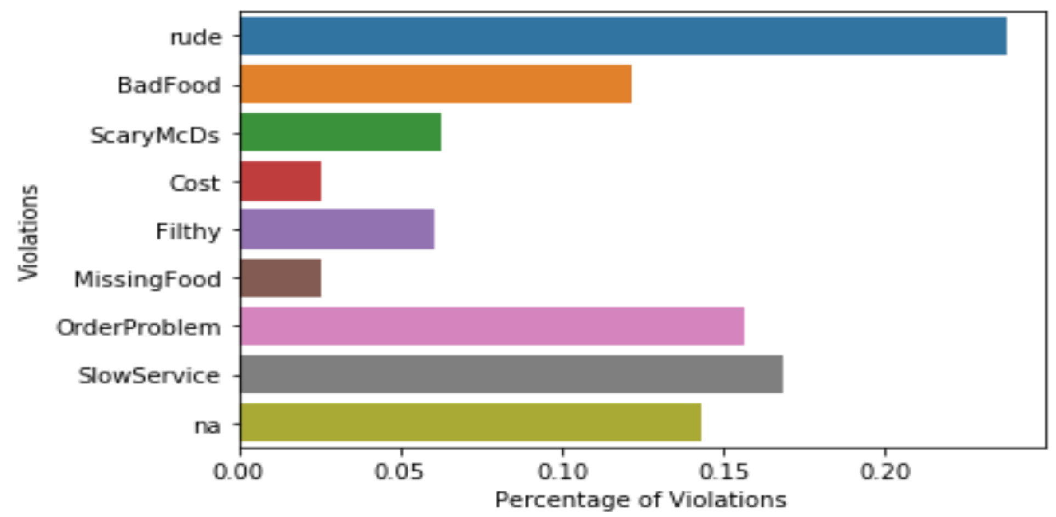
THE BUSINESS QUESTION
‘‘ Is it possible to only identify the most alarming ‘rudest’ review, so that timely action can salvage brand reputation and save from possible customer churn? ’’

Slide 6
McDONALD CUSTOMER REVIEW DATASET
City | Violation | Customer Reviews
Sydney | Rude Service | El personal siempre es grosero y molesto de que estés allí
Brisbane | Slow Service, Rude Service | Ciertamente, mi peor experiencia ¡Siempre son XTREMADAMENTE lentos!
Central Coast | Filthy Food | 当然，我最糟糕的经历总是非常慢！
Melbourne | Bad Food, Order Problem | 糟糕的服务！
Sydney | Missing Food | One Star and I'm being kind. Hello? management? Where are You?
Brisbane | Rude Service | I'm not a huge McDonald lover, but I've been to better ones. The staff is terribly unfriendly and nobody seems to care.
Atlanta | Rude Service | स्टाफ हमेशा असभ्य और परेशान होता है कि आप वहां हैं
Perth | Slow Service | 当然，我最糟糕的经历总是非常慢！
Melbourne | Bad Food, Filthy Food | خوفناک خدمت!
* Sourced from http://www.crowdflower.com. Some text were translated to Spanish for this project, to allow for translation to English.

Slide 7
THE DATA QUESTION
‘‘ Using Natural Language Processing techniques, is it possible to do the following ’’
Detect the language of the review?
Translate it into English?
Perform sentiment analysis?

Slide 8
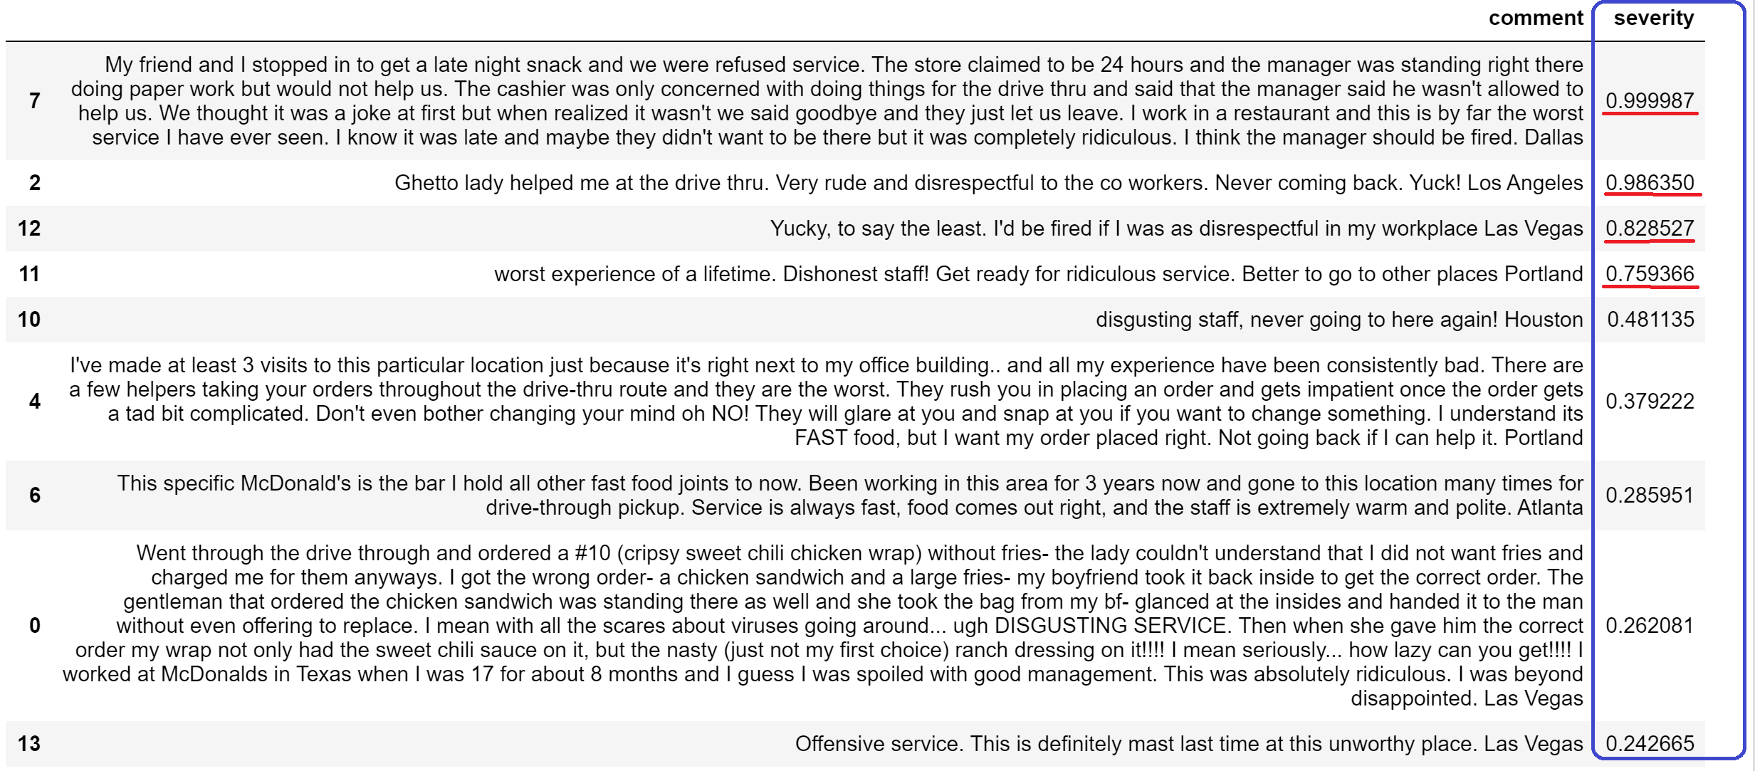
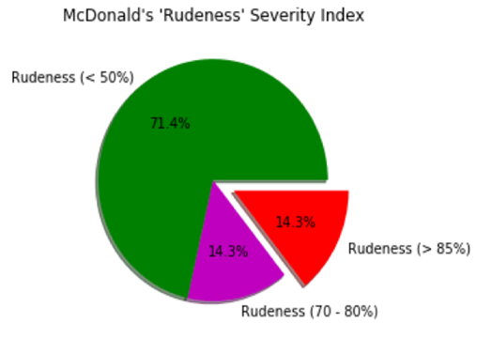
‘RUDENESS’ SEVERITY DASHBOARD

Slide 9
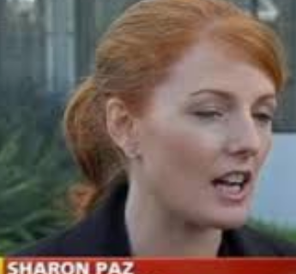

VALUE PROPOSITION
Stakeholder: Sharon Paz, Director of Operations, McDonald’s Australia
2018 Australian Revenue: $1.7 billion
Eliminate hiring $ for expert staff required to arrive at such a comprehensive real-time dashboard
A conservative estimate of 0.5% increase in annual revenue, increases McDonald's Australian revenue by $8.5 mil

Slide 10
AGENDA
AGENDA
Business Problem definition
Project Context
Delivery
Next steps and summary

Slide 11
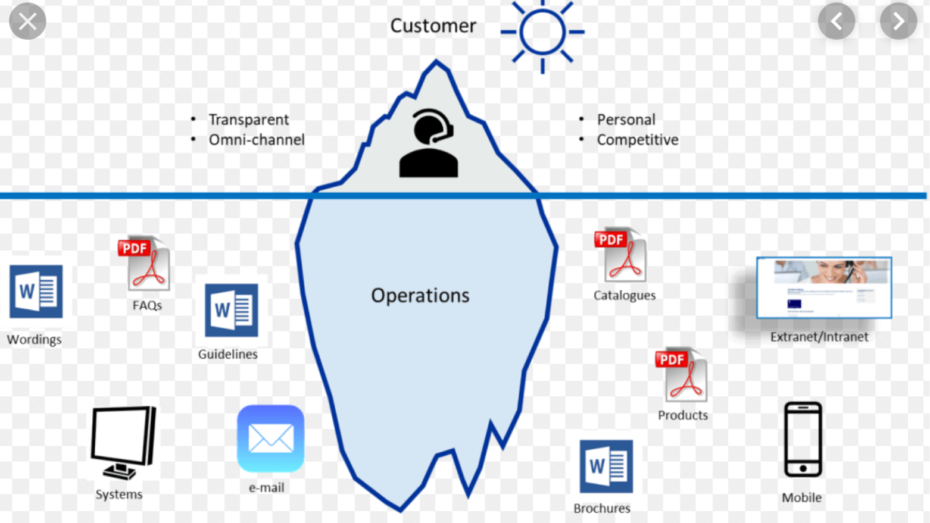
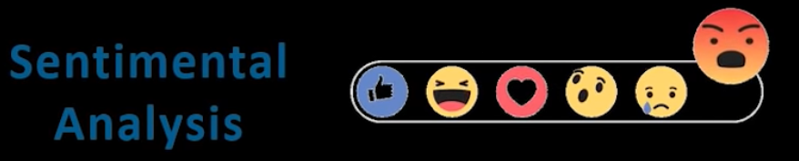



NLP APPLICATIONS
AGENDA

Slide 12
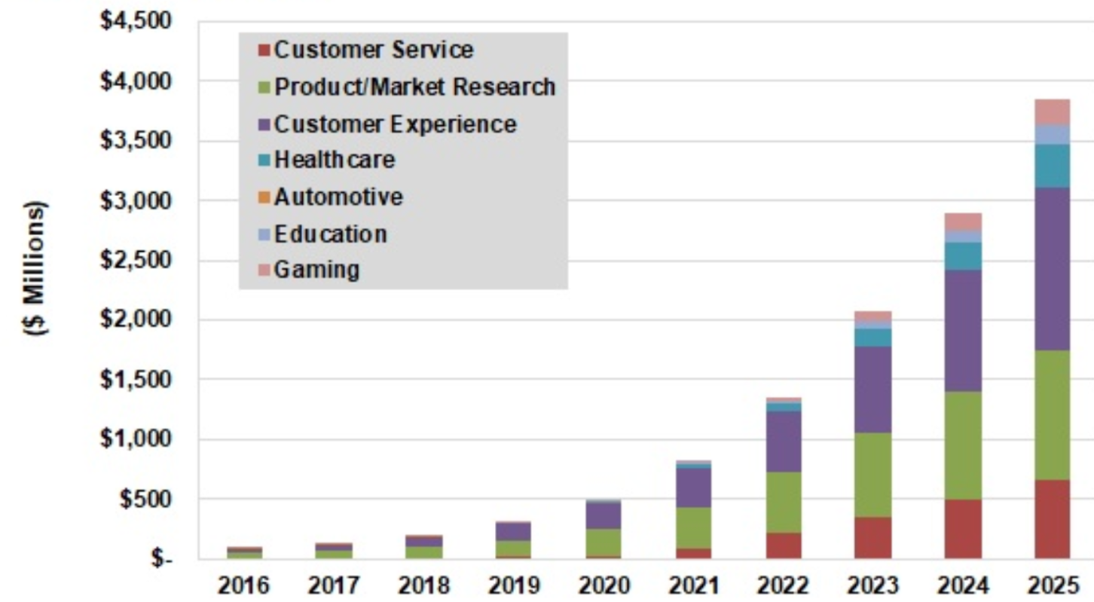
Sentiment Analysis Projected Revenue Revenue
AGENDA
* World Markets (Source: Tractica)

Slide 13
AGENDA
AGENDA
Project Context
Business Problem definition
Delivery
Next steps and summary

Slide 14
‘RUDENESS’ SEVERITY DASHBOARD

Slide 15
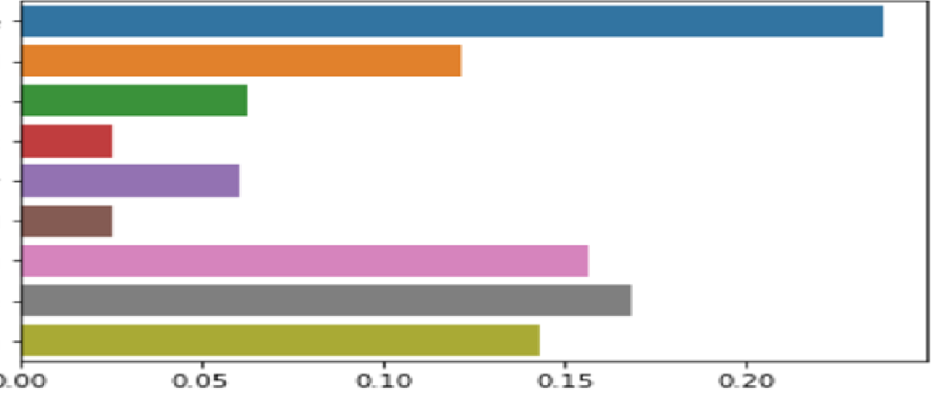
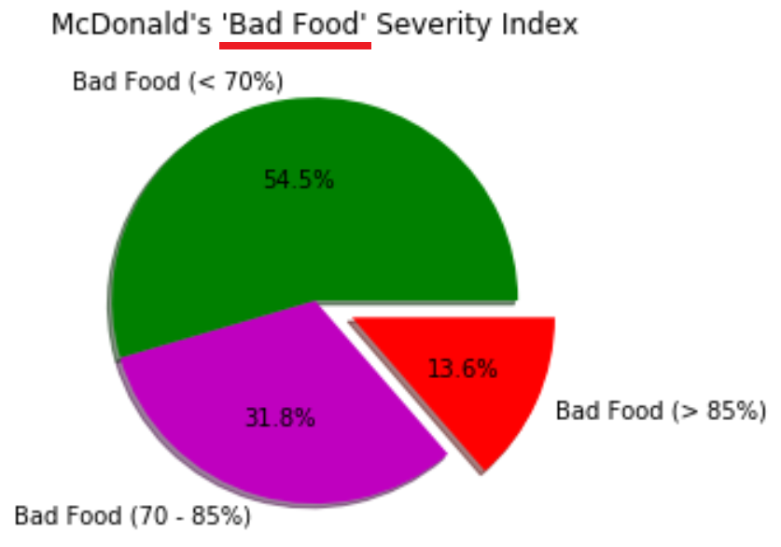
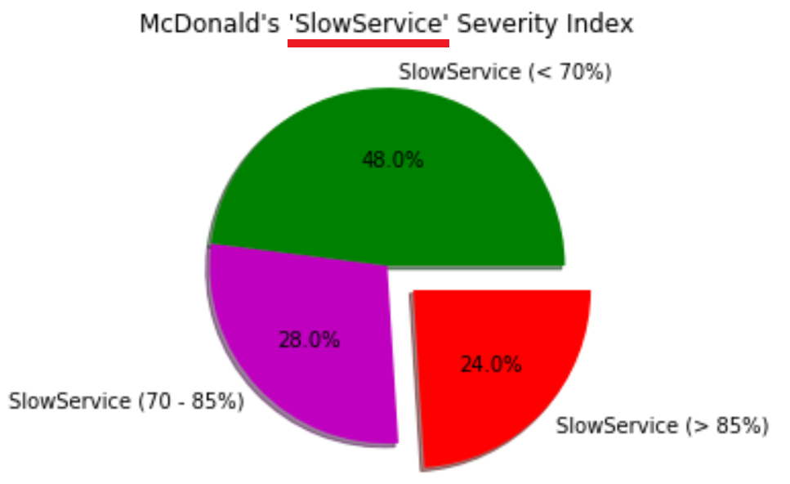
UNDERPERFORMING STORE-WISE NEGATIVE SENTIMENTS DASHBOARD
ARMIDALE NSW
COFFS NORTH NSW
COFFS SERVICE CENTRE NSW
GUNNEDAH QLD
NARRABRI TAS
GUNNEDAH QLD
GOONDIWINDI QLD
ROMA QLD QLD
NORTHBRIDGE WA
GENERIC VIOLATION DASHBOARD

Slide 16
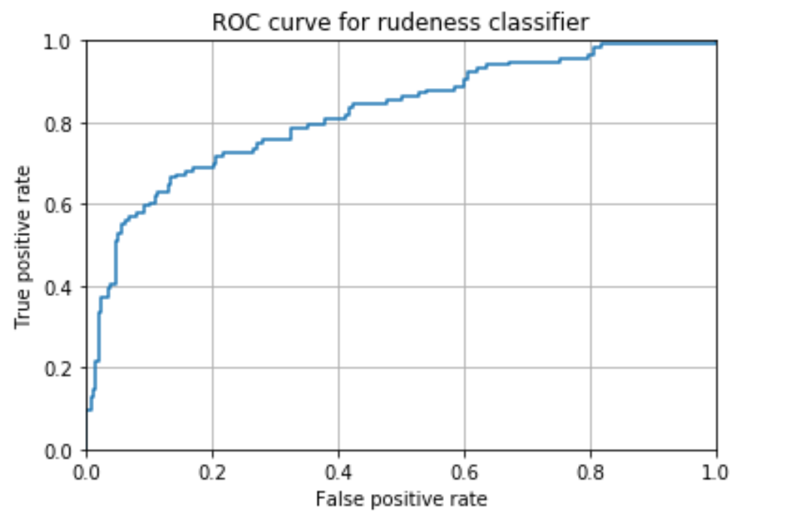
MODEL DEVELOPMENT & EVALUATION
A language translation model was first trained on over 23K Spanish to English translation dataset, and then the classification model was trained on over 1500 customer online reviews.
Classification Model | AUC
Baseline | 0.50
Logistic Regression | 0.81
Deep Learning | 0.81*
Naïve Bayes (Multinomial) | 0.83
COMPLEXITY
* results on validation set, as model performed badly with less train-”test” data. Less data was the limiting fact.

Slide 17
AGENDA
AGENDA
Project Context
Business Problem definition
Delivery
Next steps and summary

Slide 18
NEXT STEPS
Deploy model
Implement text summarization

Slide 19
SUMMARY
Business question
Is it possible to identify the most alarming ‘rudest’ reviews from the ton of customer online reviews that get posted each day?
Data question
Using NLP techniques, is it possible to detect the language of the review, translate it into English, and perform sentiment analysis?
Data process
Clean dataset: remove foreign characters, stop words etc.
Create and Evaluate language translation model
Create features based on:
Term frequency
Document frequency
Create and Evaluate classification model & select best
Data answer
Yes, we can predict the top ranking ‘rudest’ reviews with an AUC metric of 83%
Business answer
Conservative estimate of 0.5% increase in annual revenue, increases McDonald's Australian revenue by $8.5 mil

Slide 20
Thank You!
Supporting documentation
@ https://github.com/seqprav/DSIA-SYD-FT-Projects-201907/tree/master/Praveen/CAPSTONE

